Slide 1

Project Management Life Cycle System for Student Project Tracking
Theme- Quality Education
Category- Software
Group No -15
Group Members-Lara Joshi, Kalash Kotecha, Rushabh Gosavi
Guide-Prof .Shruthi Nair Mam

Slide 2
Need for automation in academic project handling
Background
Growing number of student projects in colleges
Manual tracking using Excel and paper records
Difficulty in monitoring project progress
Need for centralized digital system
Lack of structured lifecycle approach
Need for automation in academic project handling
Digital transformation in education sector

Slide 3
Importance & Challenges
Importance-Ensures organized project allocation
Avoids duplication of project topics
Helps faculty monitor progress
Current Challenges-Manual Excel-based management
Data redundancy issues
No role-based access control

Slide 4
Motivation & Objectives
Motivation-Observed inefficiency in manual systems
Delays in project approvals
Miscommunication between students & faculty
Need for transparent system
Objectives-Develop centralized web-based system
Manage student & project data efficiently
Track complete project lifecycle

Slide 5
LITERATURE SURVEY

Slide 6
Existing Solutions
ERP systems (Student Information Systems)
Learning Management Systems (LMS)
Online Project Management Tools
Google Sheets & manual databases
GitHub for project version tracking

Slide 7
Techniques Used
Database Management Systems
Role-based Authentication Systems
Cloud-based storage systems
Web-based dashboard interfaces
CRUD operations for data handling
Reporting & analytics modules

Slide 8
Limitations of existing Systems

Slide 9
Manual approval processes
Data inconsistency
No automated project allocation
No milestone tracking
Limited security measures
No centralized repository
Lack of scalability
No performance comparison tools

Slide 10
Problem statement and Objectives

Slide 11
Manual and semi-digital systems fail to efficiently manage student project lifecycle, causing duplication, poor monitoring, and data mismanagement.
Key Issues to Address
Centralized data storage
Secure authentication
Structured lifecycle tracking
Automated allocation system
Report generation

Slide 12
OBJECTIVES
Design structured project lifecycle framework
Implement multi-user login system
Develop relational database schema
Provide real-time project updates
Enable faculty monitoring dashboard
Generate project analytics reports
Improve transparency and efficiency

Slide 13
Proposed Methodology

Slide 14
System Modules
Admin Module (Manage students, projects)
Student Module (Select & track project)
Faculty Module (Approve & review)
Reporting Module (Generate analytics)
Authentication Module (Secure login)
Lifecycle Phases
Project Proposal Submission
Faculty Approval
Development Phase
Review & Evaluation
Final Submission & Completion

Slide 15
Database Design
Student Table
Project Table
Faculty Table
Allocation Table
Progress Tracking Table
Algorithms Used
CRUD Operations
Role-Based Access Control
Validation & Authentication logic
Auto Project Assignment Logic
Value Addition
Automatic duplicate detection
Progress percentage calculation
Dashboard analytics
Secure session management

Slide 16
Implementation

Slide 17
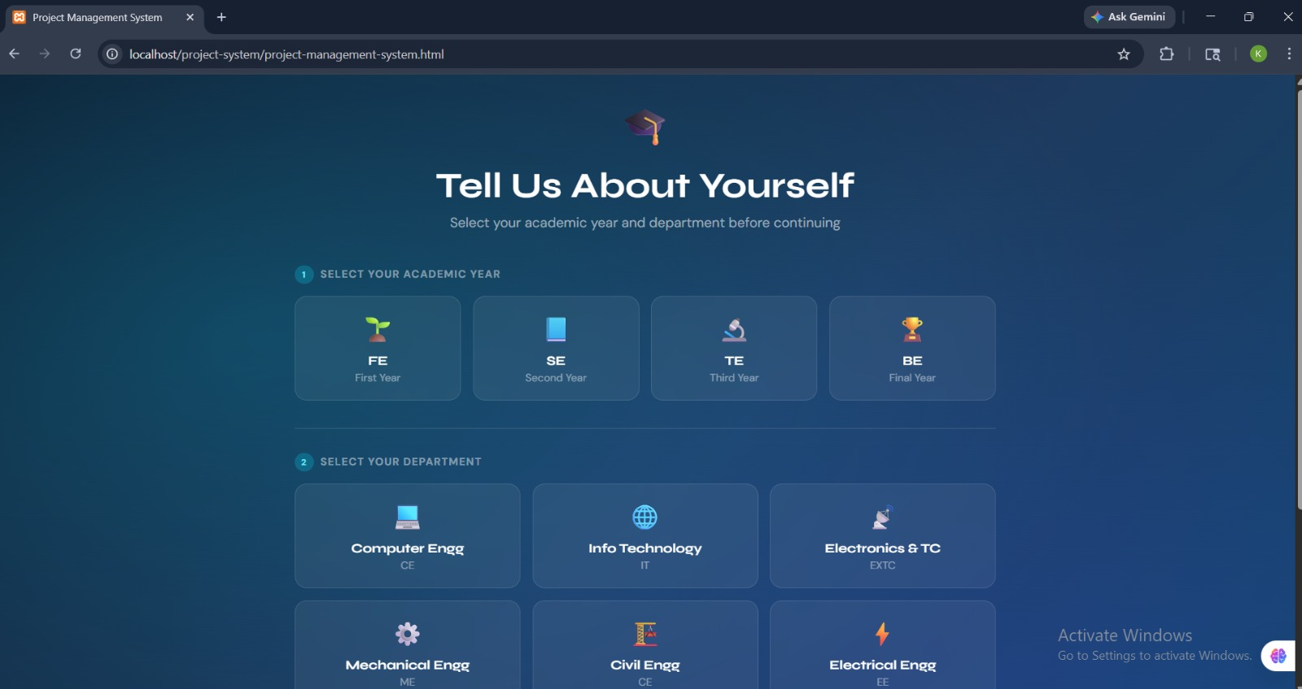

Slide 18
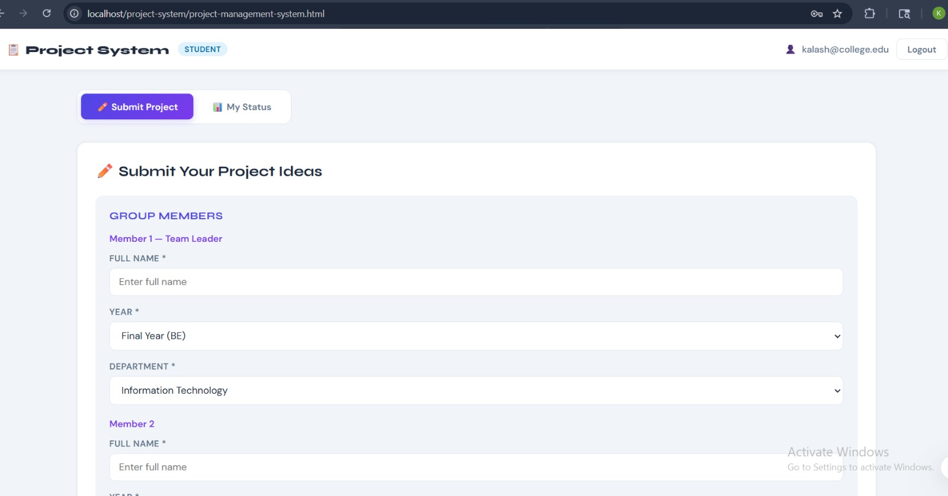

Slide 19
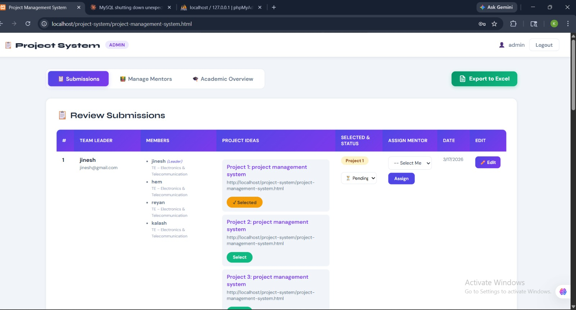

Slide 20
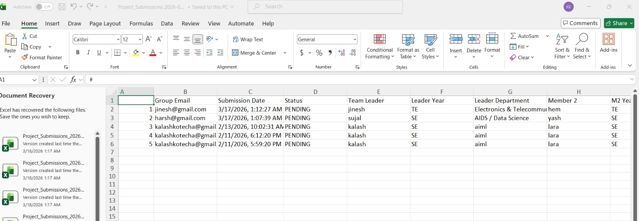

Slide 21
Results & Analysis

Slide 22
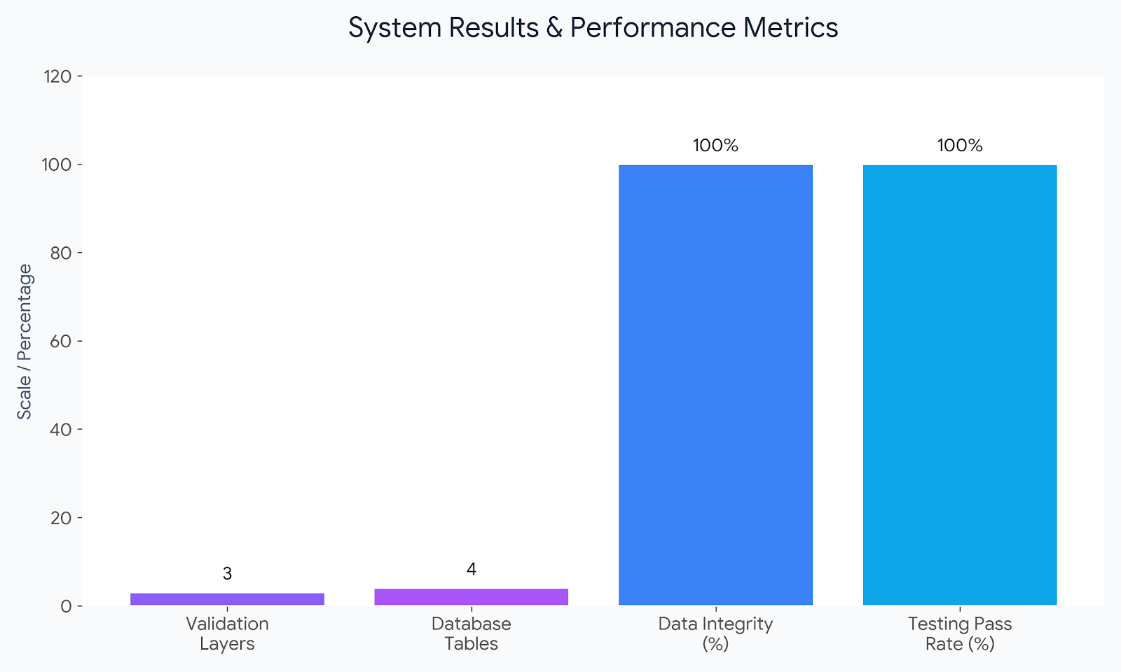

Slide 23
Conclusion and Future work

Slide 24
Improved transparency in project management
Successfully implemented centralized tracking system
Structured lifecycle implementation
Secure and efficient database handling
Alignment with SDG 4 goals
FUTURE WORK
Cloud deployment
AI-based project recommendation
SMS/Email notifications
Mobile app version
Integration with college ERP
Advanced analytics dashboard
Plagiarism detection integration

Slide 25
References
Research papers on Student Management Systems
Web-based Project Tracking Systems
Database Management System references
IEEE format citations

Slide 26
Thank You...!!

